Slide 1

A Deep Convolutional Neural Network -Based Approach For Signature Forgery Detection In Documents
Team no.3
MLA0405 – Deep Learning
Guided By Students Name
Dr.A.M.Arul Raj N.Akshaya-192425129
Professor Yoga Madha.A -192425058
SIMATS Engineering
Notes:
1
1

Slide 2
Abstract
Develops a Deep Convolutional Neural Network (DCNN) to detect forged and genuine signatures automatically.
Preprocesses signature images using resizing, grayscale conversion, and normalization to improve model performance.
Extracts important signature features automatically without requiring manual feature engineering.
Classifies signatures accurately as genuine or forged using deep learning techniques.
Evaluates the model using performance metrics such as Accuracy, Precision, Recall, F1-Score, and Confusion Matrix.

Slide 3
Aim and Objective
Aim:
To develop a Deep Convolutional Neural Network (DCNN)-based system for accurately detecting forged signatures in documents by automatically learning signature features and classifying signatures as genuine or forged.
Objectives:
To collect and preprocess genuine and forged signature images for model training and testing.
To develop a Deep Convolutional Neural Network (DCNN) for accurate classification of signatures as genuine or forged.
To evaluate the performance of the proposed model using metrics such as Accuracy, Precision, Recall, and F1-Score.

Slide 4
Introduction
Signature verification is an important process used to authenticate documents and prevent fraud in banking, legal, and business applications.
Manual signature verification is time-consuming, subjective, and prone to human errors, making automated solutions essential.
Deep learning techniques, especially Deep Convolutional Neural Networks (DCNNs), can automatically learn complex features from signature images.
A DCNN-based approach improves the accuracy and reliability of distinguishing genuine signatures from forged ones.
The proposed system preprocesses signature images and classifies them as genuine or forged using a trained deep learning model.

Slide 5
Literature Review & Requirement Analysis
S.No | Year of Publication | Author(s) | Title of the Journal / Book | Methodology Used | Algorithm Used | Key Findings
1 | 2026 | Zhang et al. | IEEE Access – Deep Learning-Based Offline Signature Verification | Signature image preprocessing and deep feature extraction | DCNN | Achieved high forgery detection accuracy with reduced false positives.
2 | 2025 | Kim et al. | Expert Systems with Applications – Signature Forgery Detection Using Deep Learning | Offline signature classification using image analysis | CNN + Transfer Learning | Improved classification performance for genuine and forged signatures.
3 | 2024 | Li et al. | Pattern Recognition Letters | Automatic feature extraction from signature images | ResNet-50 | Enhanced verification accuracy and robustness against skilled forgeries.
4 | 2023 | Wang et al. | IEEE Transactions on Information Forensics and Security | Signature verification using deep neural networks | CNN | Produced reliable authentication with lower error rates than traditional methods.
5 | 2022 | Chen et al. | Computers & Security | Image preprocessing and signature classification | VGG16 | Improved forgery detection accuracy but required a large training dataset.

Slide 6
Problem Statement
Manual signature verification is time-consuming, inconsistent, and prone to human errors, making it difficult to accurately detect forged signatures in important documents.
Traditional signature verification methods rely on handcrafted features and often fail to identify skilled forgeries, highlighting the need for an accurate and automated Deep Convolutional Neural Network (DCNN)-based detection system.

Slide 7
Existing System
Manual verification: Signature authentication is mainly performed by human experts, making the process slow and prone to errors.
Traditional feature extraction: Existing methods rely on handcrafted features, which are often ineffective in detecting skilled forgeries.
Limited accuracy: Conventional machine learning techniques may fail to capture complex signature patterns, resulting in lower detection accuracy.
Poor scalability: Existing systems require significant manual effort and are not suitable for processing large volumes of documents efficiently.

Slide 8
Proposed System
The proposed system uses a Deep Convolutional Neural Network (DCNN) to automatically learn and extract important signature features from document images.
It applies image preprocessing techniques such as noise removal, resizing, and normalization to improve signature analysis.
The extracted signature patterns are analyzed by the DCNN model to differentiate between genuine and forged signatures.
The system provides an efficient and accurate approach for automatic signature verification and forgery detection.
It reduces human effort and improves the reliability of document authentication processes.

Slide 9
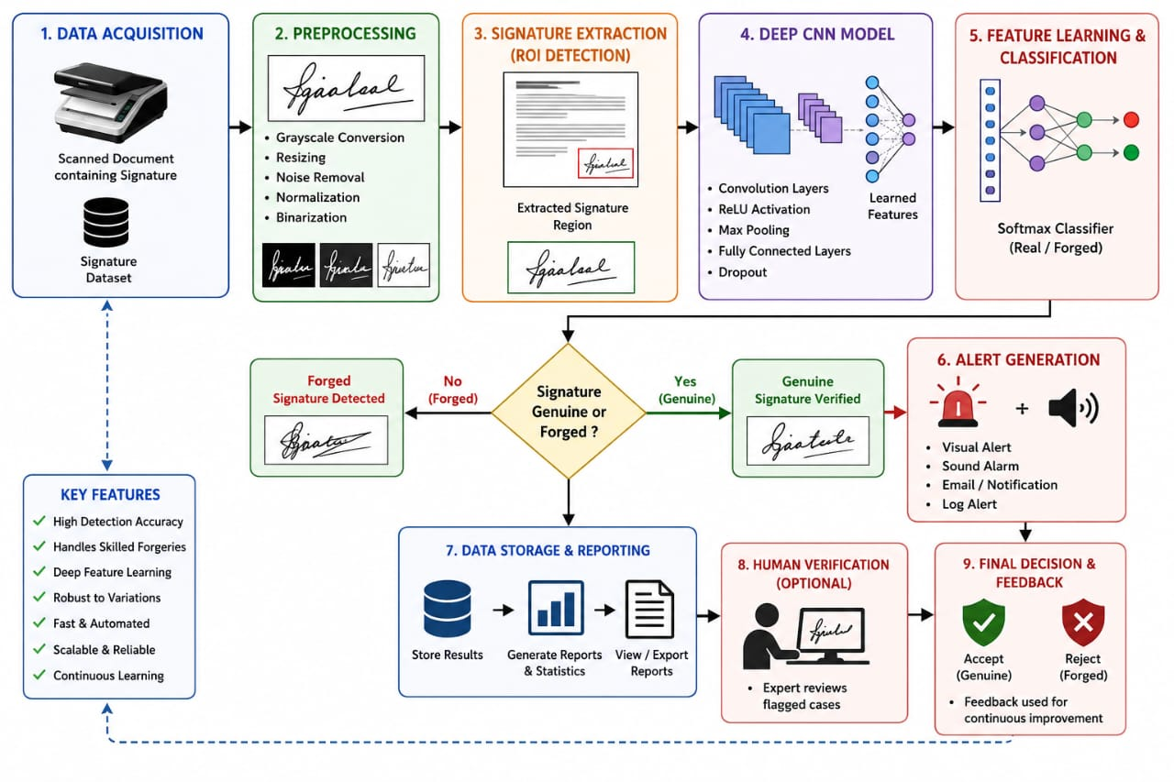
Overall System Architecture Design

Slide 10
Design & Module Planning
Module 1: Signature Image Processing & CNN-Based Detection
Module 2:Forensic Analysis & Verification Dashboard

Slide 11
Module 1: Signature Image Processing & CNN-Based Detection
Upload signature image through web interface
Preprocess → Grayscale → Resize → Normalize
Extract Features → Stroke Density → Aspect Ratio → Width & Height →
Connected Components → Sharpness & Brightness
CNN Classification → Trained Deep CNN Model
Prediction → Genuine / Forged
Calculate → Genuine & Forged Probability
Display → Confidence Score
Generate → CNN Heatmap for Important Signature Regions

Slide 12
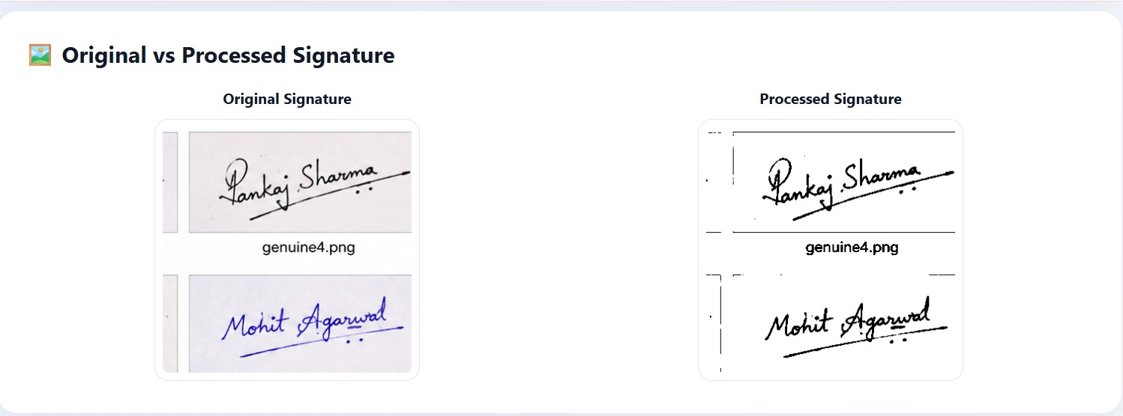
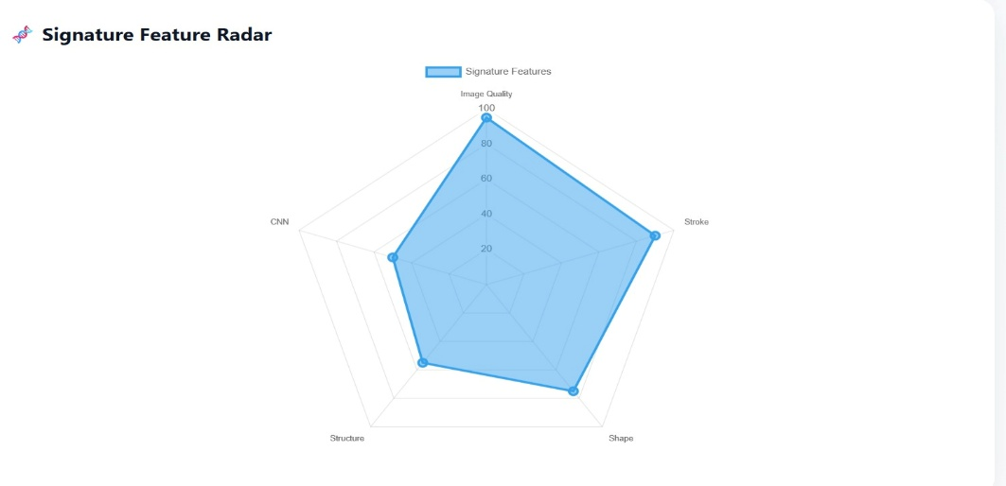
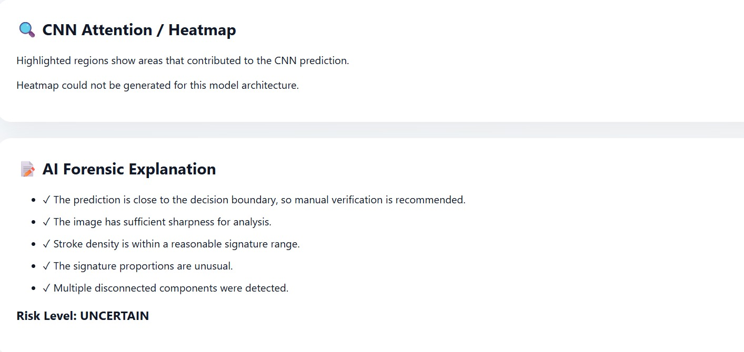

Slide 13
Module 2:Forensic Analysis & Verification Dashboard
Original vs Processed Signature – Visual comparison
Forgery Scorecard – Detailed forgery analysis
Forensic Score – Overall authenticity score
Radar Chart – Signature characteristics visualization
AI Explanation – Reason for the prediction
Risk Level – Low / Medium / High / Uncertain
Signature Comparison – Reference vs Questioned Signature
Similarity Percentage – Measures signature matching
Verification History – Stores previous analyses
PDF Report – Generates professional analysis report
Dark/Light Mode – User-friendly interface

Slide 14
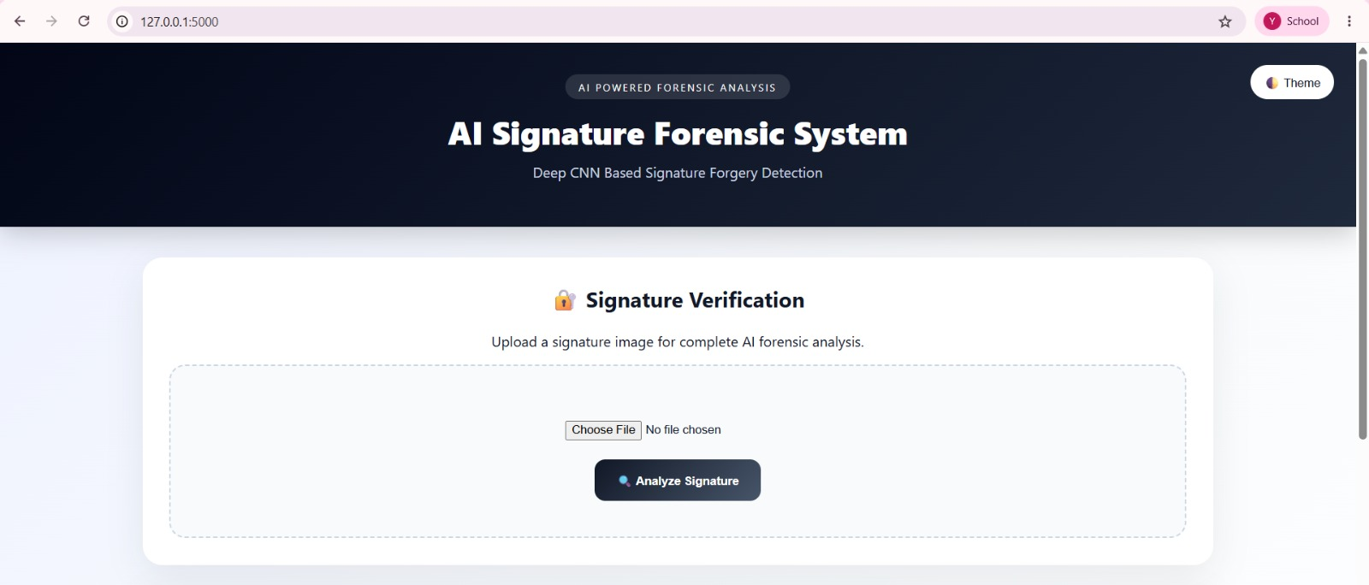
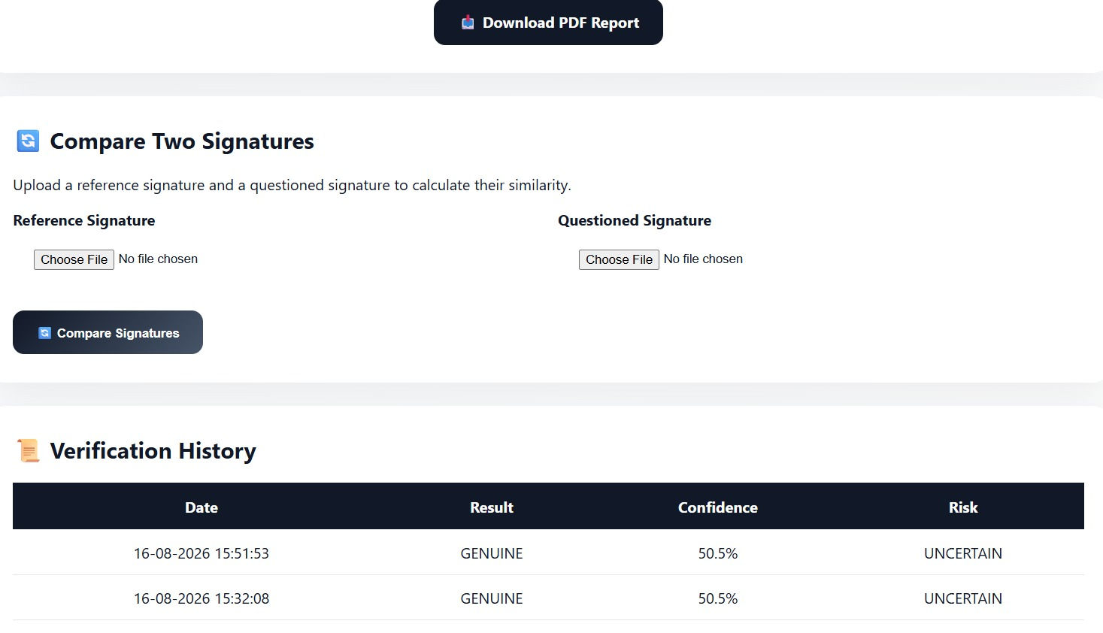
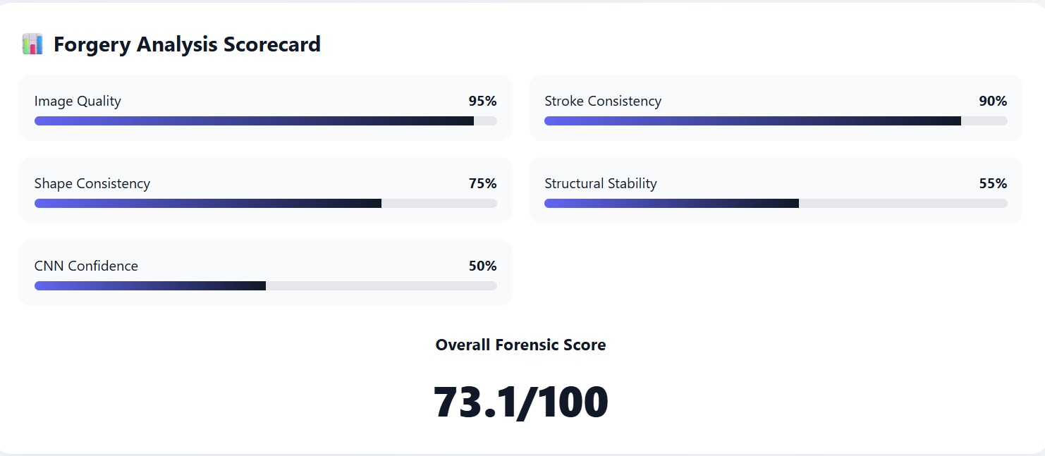

Slide 15
Conclusion
Problem: Signature forgery in documents is a major challenge that affects document security and authentication due to the limitations of traditional manual verification methods.
Solution: The proposed DCNN-based signature forgery detection system provides an automated approach by using image preprocessing and deep learning techniques to extract signature features and classify signatures as genuine or forged.
Impact: The system improves the accuracy, speed, and reliability of signature verification while reducing human effort in document authentication.
Significance: This project demonstrates the importance of deep learning in developing secure and efficient solutions for detecting signature fraud in digital documents.

Slide 16
References
LeCun, Y., Bengio, Y., & Hinton, G. (2015). Deep Learning. Nature, 521, 436–444.
Hafemann, L. G., Sabourin, R., & Oliveira, L. S. (2017). Learning Features for Offline Handwritten Signature Verification Using Deep Convolutional Neural Networks. Pattern Recognition, 70, 163–176.
Dey, S., Dutta, A., Toledo, J. I., et al. (2017). SigNet: Convolutional Siamese Network for Writer Independent Offline Signature Verification. IEEE International Conference on Document Analysis and Recognition (ICDAR).
He, K., Zhang, X., Ren, S., & Sun, J. (2016). Deep Residual Learning for Image Recognition. IEEE Conference on Computer Vision and Pattern Recognition (CVPR).
Goodfellow, I., Bengio, Y., & Courville, A. (2016). Deep Learning. MIT Press.

Slide 17


